Slide 1
Module 10: Animations
SER 423

Slide 2
Overview
Animations can be a nice way to add a little extra flair to your apps
Most apps have a small baseline of minor animations
Keep in mind that by animations, we can mean very simple things
  Fading in or out
  Sliding to the left or right
  Highting an action
  Etc.
Overall, for most cases animations are not required, but provide a better user experience
Items are either easier to notice, or changes are less jarring
We’ll look at some of the ways both platforms handle animating elements of a View

Slide 3
Animations in Android

Slide 4
Tween Animation
This is one of the most basic ways to animate elements in Android
The actual code to run the animation is simple
You just need to load the animation with AnimationUtils.loadAnimation
Then have an ImageView and call startAnimation on it and pass in the animation object created in the previous step
Animation has methods for start, setting the duration, ending, and cancelling early
Where this gets tricky is that first step - we have to pass in a defined animation
We have to define the animation in an XML file
We essentially have to define step by step what the animation will do
It’s not as tedious as you might think, but still a pain for longer or more detailed animations

Slide 5
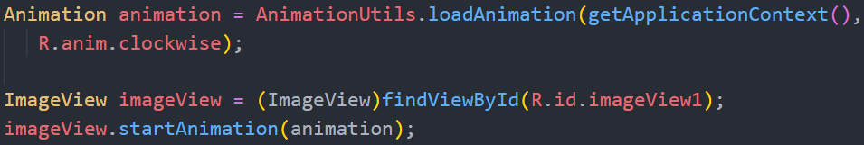
The Code for Tweening

Slide 6
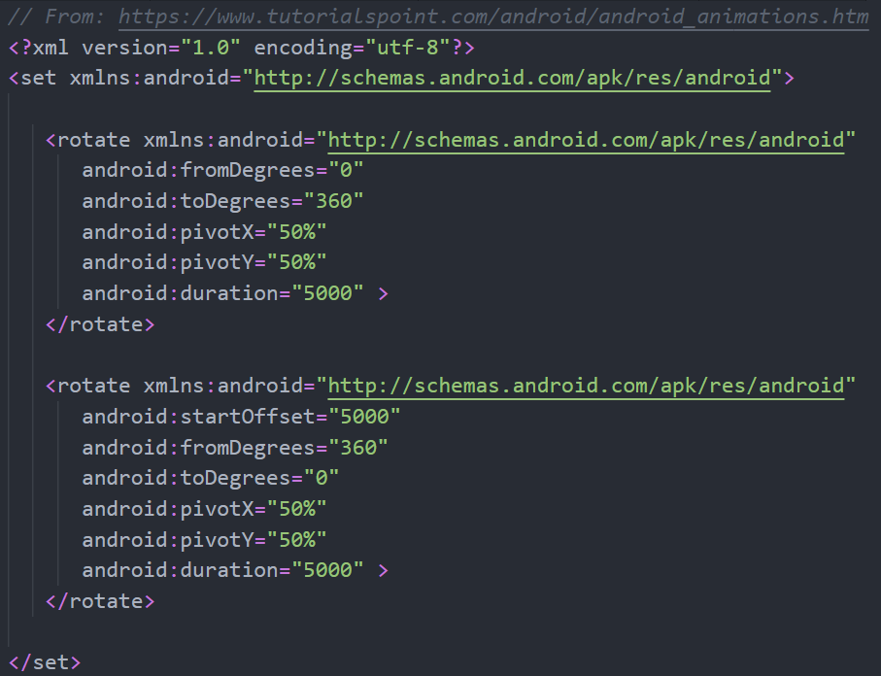
The Animation Itself

Slide 7
Animating Drawables
An alternative that you might find easier to work with is using Drawables
This let’s you specify a series of static images
These are then displayed one at a time
Moving between the images quickly creates the illusion of movement
  This is how actual hand drawn animation works
We still have to define the set of files within an XML sheet
But now all we need to do is list out the file names, and how long each of those files should be shown for
Then in the app itself, we load that as a resource and start playing when we want it to

Slide 8
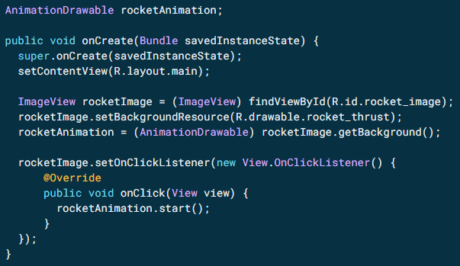
Within the App

Slide 9
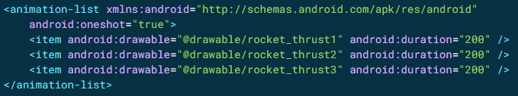
The XML File

Slide 10
iOS Animations

Slide 11
Animations in UIView
UIView is the package that holds the animation logic in iOS
The nice thing here is that some of the basic animations are built in
There’s no need to define some of them like you needed to in Android
For starter, you need to define a constraint for the element you want to animate
If you do this in viewWillAppear (and you should!) this will move the element from its specified position to the one you define with the constraint
You can then modify viewDidAppear to remove the constraint and tell UIView to animate the element… if needed
The layout knows where the element should be, but the constraint has moved it
It will snap to the right place, but you can provide a duration and it will smoothly animate it from its current position to the correct one over that duration

Slide 12
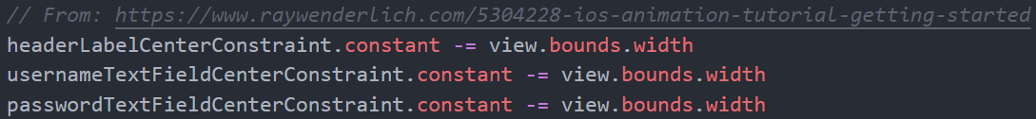
ViewWillAppear

Slide 13
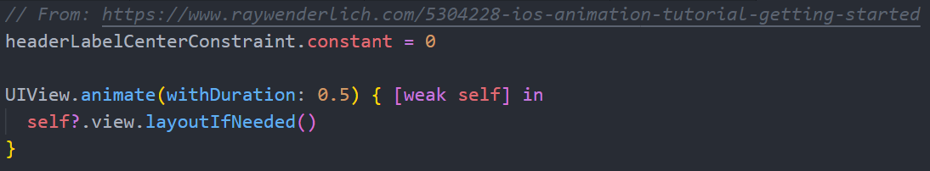
ViewDidAppear

Slide 14
Creating Custom Animations
So we can create basic movement animations using constraints but what about custom animations?
Well, UIView.animate has a lot of other optional parameters we can add to customize how the animation looks
One of these parameters is to actually provide an animation
We just need to provide a frame for the element that represents how it will look after the animation has finished
So create the element first, with its starting size and position, then add the frame here in the animation with the new size and position
Finally, also within the animation, it is good to provide a center point for the element

Slide 15
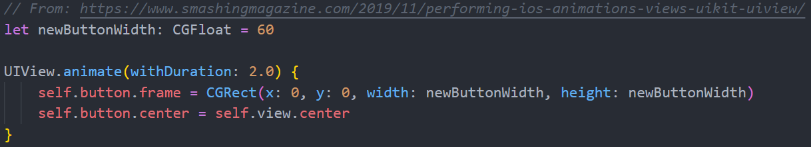
A Basic Button Animation

Slide 16
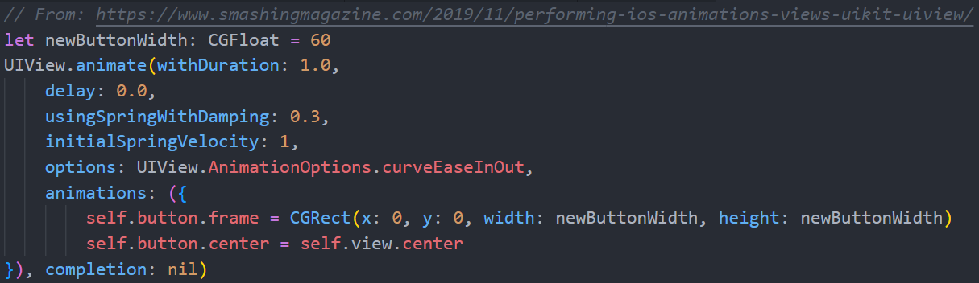
A More Complex Example

Slide 17
End of Animations
Next time - Animations in React

